Slide 1
Monetary Policy Report
January 2020
    In focus The labour market

Slide 2
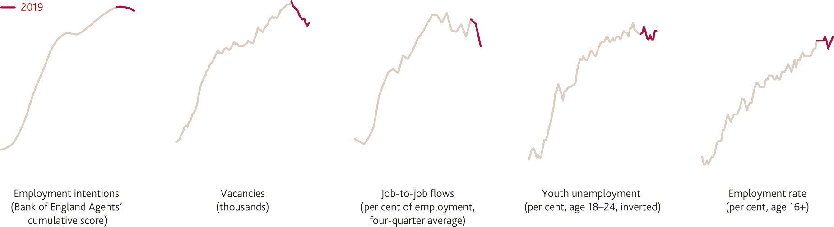
  Chart 3.1 Some labour market indicators softened in 2019, but employment has remained close to its record high
    Selected labour market indicators, 2013–19^{(a)}
Sources: Bank of England, ONS and Bank calculations.
(a) See Chart 3.2 for more on employment intentions, Chart 3.4 for more on vacancies, Chart 3.7 for more on job-to-job flows and Chart 3.10 for more on youth unemployment.

Slide 3
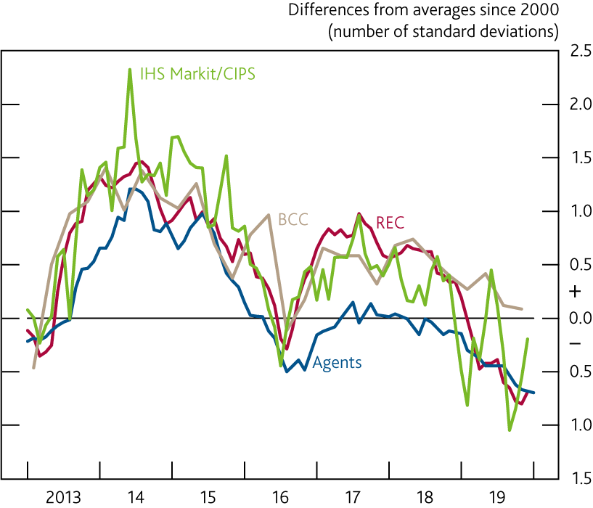
  Chart 3.2 Surveys of employment intentions have weakened
    Surveys of employment intentions^{(a)}
Sources: Bank of England, BCC, IHS Markit/CIPS, KPMG/REC Report on Jobs and Bank calculations.
(a) Surveys from the Bank’s Agents (employment intentions over the next 12 months), BCC (employment expectations over the next three months), IHS Markit/CIPS (PMI composite employment index) and KPMG/REC (index of demand for new staff). Agents’ scores are monthly until August 2016 and six weekly thereafter. BCC data are quarterly.

Slide 4
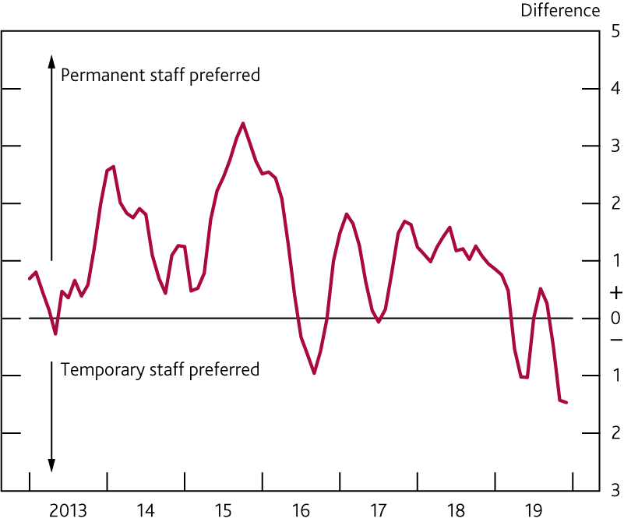
  Chart 3.3 Demand for permanent staff has been weaker than for temporary staff
    Difference between permanent and temporary staff demand indices^{(a)}
Source: KPMG/REC Report on Jobs.
(a) Three-month moving average.

Slide 5
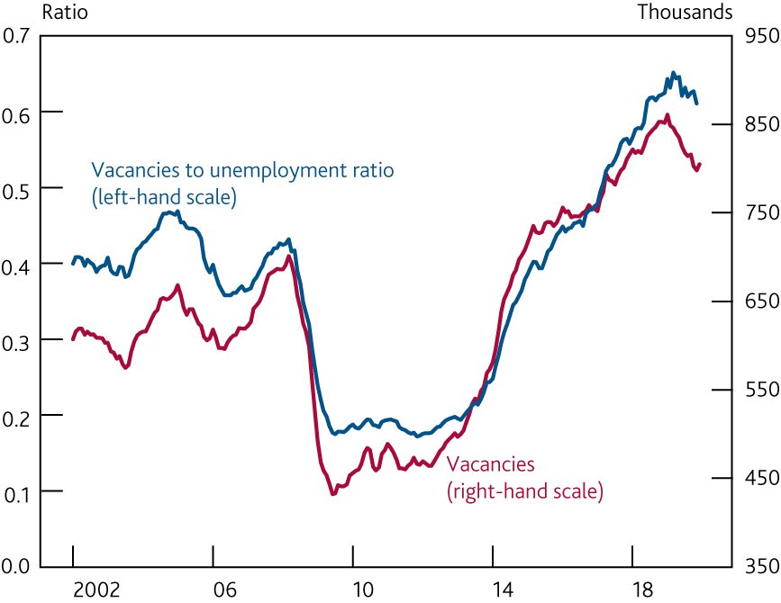
  Chart 3.4 Vacancies have fallen, but the ratio of vacancies to unemployed people remains high
    Vacancies and unemployment
Sources: ONS and Bank calculations.

Slide 6
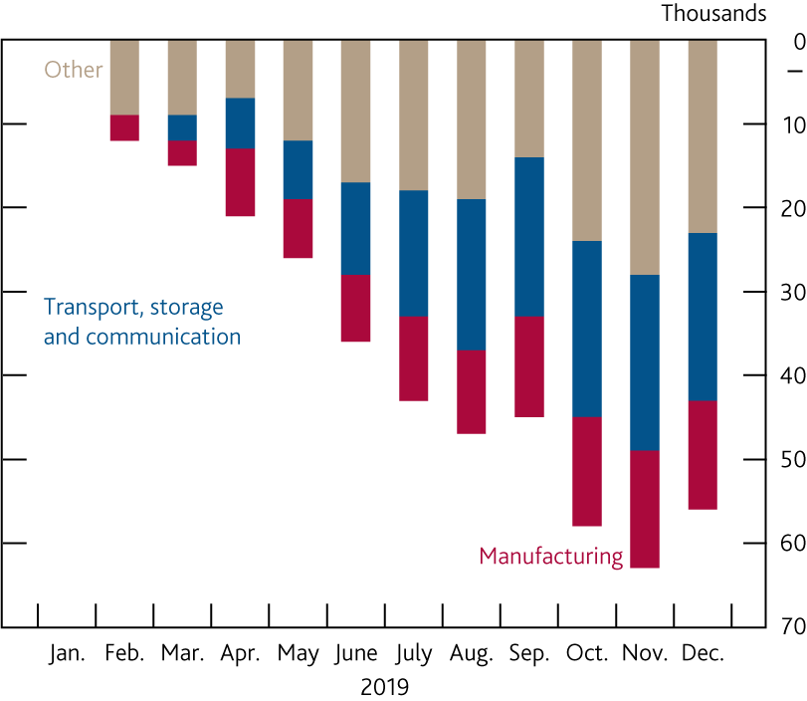
  Chart 3.5 Two sectors account for over half of the decline in vacancies
    Change in the number of vacancies since January 2019 by sector
Sources: ONS and Bank calculations.

Slide 7
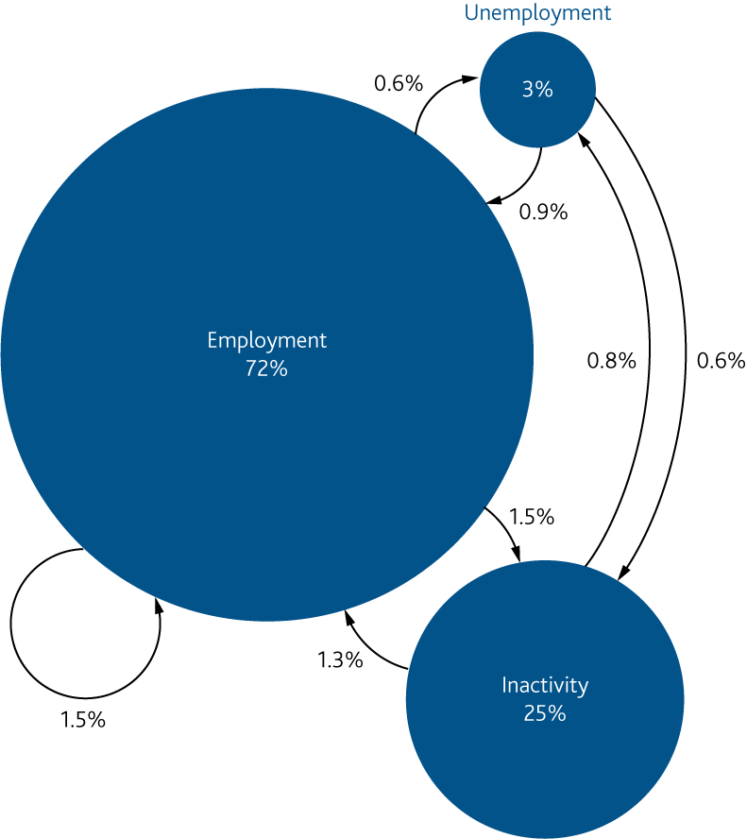
  Chart 3.6 The flows between labour market states offer an alternative perspective
    Employment, unemployment and inactivity as a proportion of the
    working-age population in 2019 Q2–Q3^{(a)}
Sources: Labour Force Survey and Bank calculations.
(a) Bank staff estimates using the Labour Force Survey. Stocks and flows are expressed as proportions of the 16–69 year old population. All figures are seasonally adjusted by Bank staff.

Slide 8
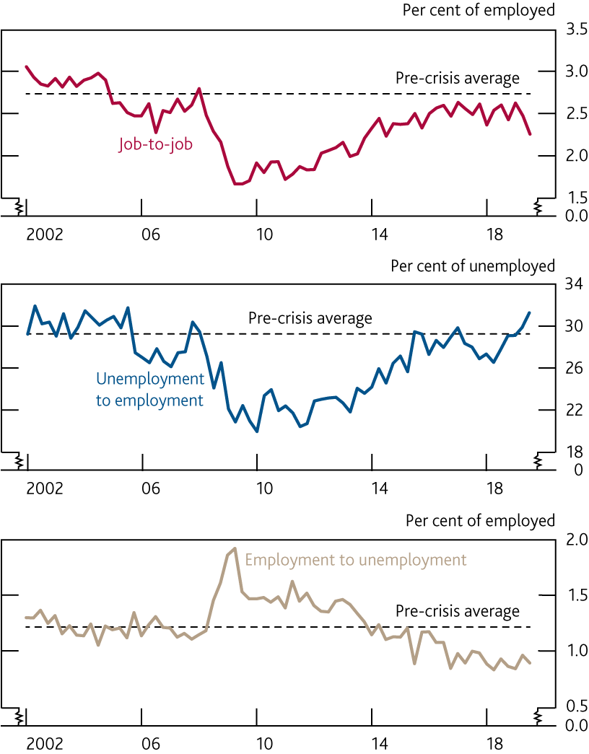
  Chart 3.7 Job-to-job flows have fallen recently; the flow out of employment into unemployment has remained low
    Job-to-job flows and flows between unemployment and employment^{(a)}
Sources: ONS and Bank calculations.
(a) Two-quarter flows. Job-to-job flows are based on total employment of people aged 16–69. Flows between employment and unemployment are based on total employment and unemployment of people aged 16–64. Dashed lines are averages from 2002 to 2007.

Slide 9
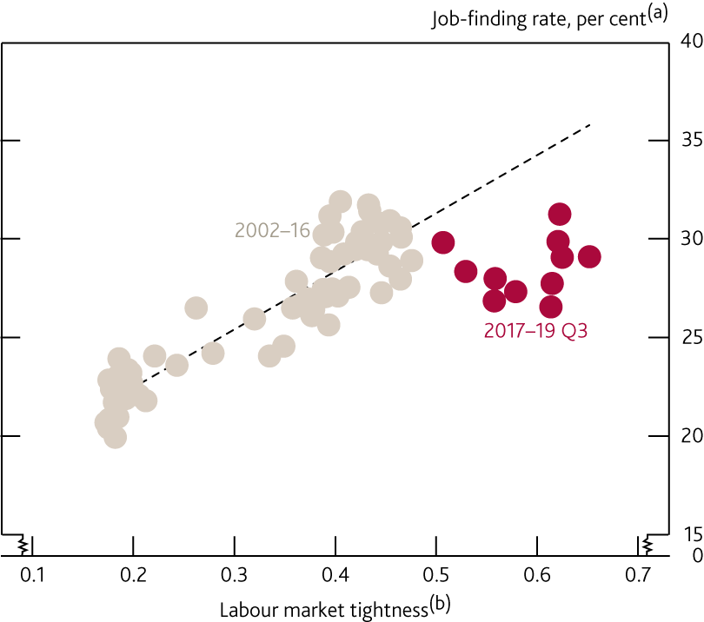
  Chart 3.8 The job-finding rate has been low given the tightness of the labour market
    Job-finding rate and labour market tightness
Sources: ONS and Bank calculations.
(a) The job-finding rate is the percentage of unemployed people that move into employment, as shown in Chart 3.7. It is a two-quarter flow based on total employment and unemployment of people aged 16–64.
(b) Measured using the vacancies to unemployment ratio, as seen in Chart 3.4.

Slide 10
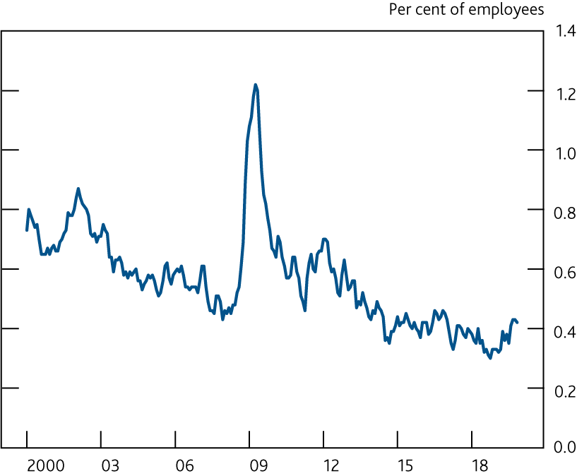
  Chart 3.9 The redundancy rate has picked up in recent months, but remains close to its record low
    Redundancy rate
Sources: ONS and Bank calculations.

Slide 11
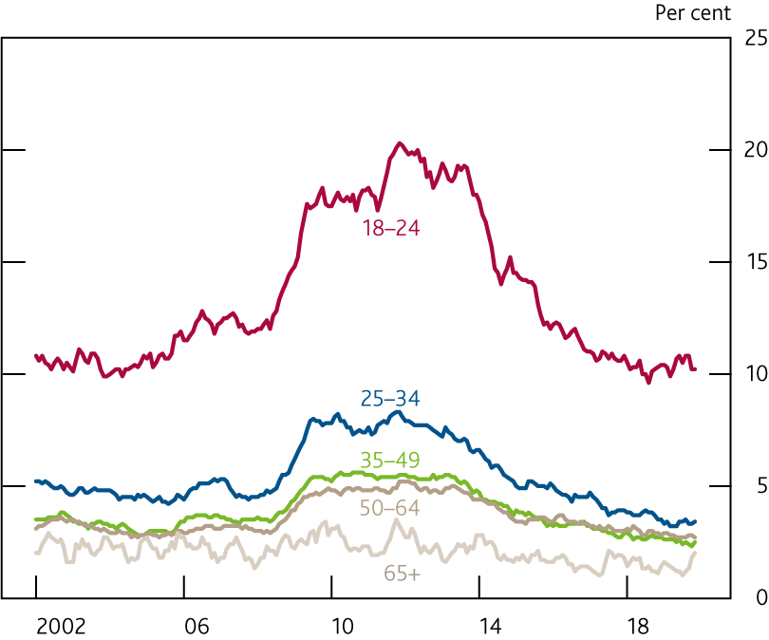
  Chart 3.10 Youth unemployment is more procyclical, but has not picked up materially
    Unemployment rates by age group

Slide 12
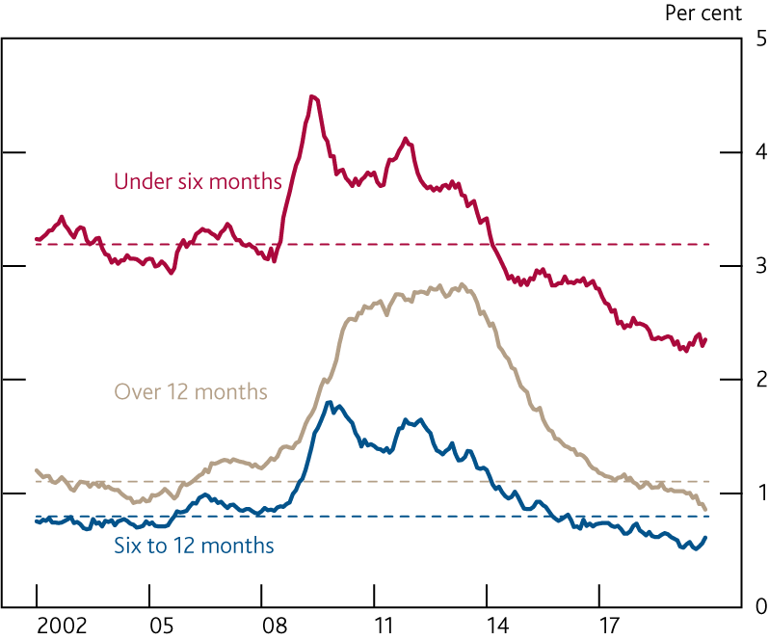
  Chart 3.11 Short-term unemployment has picked up slightly over the past year, but remains low
    Unemployment rates by duration^{(a)}
Sources: ONS and Bank calculations.
(a) The number of people unemployed in each category, divided by the economically active population. Dashed lines are averages from 2002 to 2007.

Slide 13
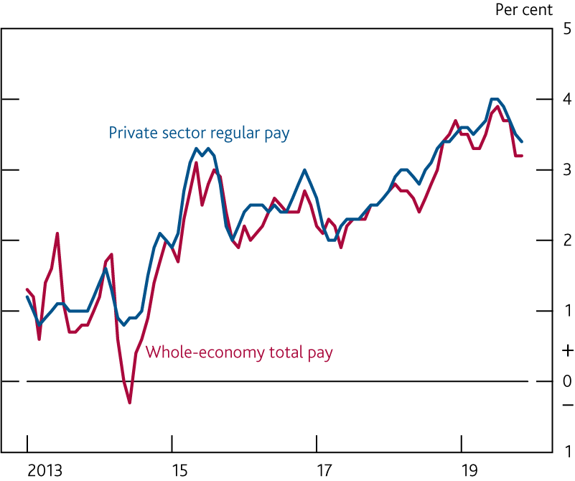
  Chart 3.12 Pay growth has slowed over the past few months, but is still higher than recent years
    Measures of pay growth^{(a)}
(a) Three-month average growth on the same period a year earlier.

Slide 14
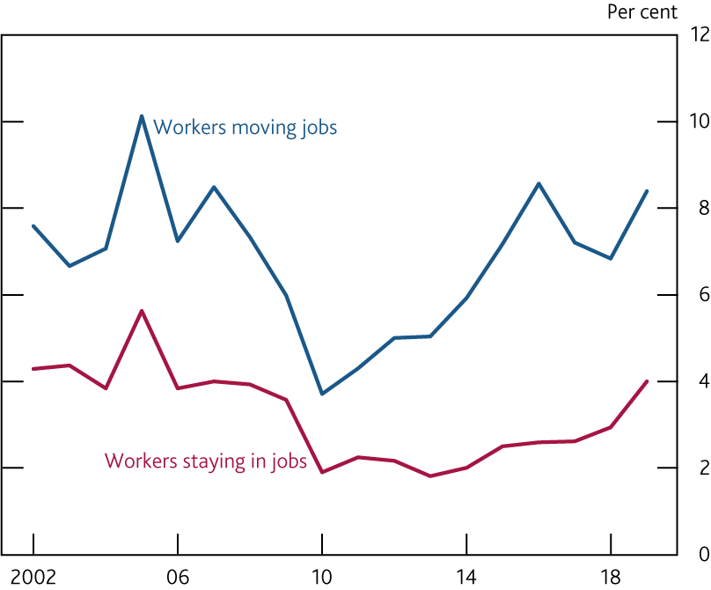
  Chart 3.13 Pay growth picked up in the year to April 2019 for those staying in jobs as well as those moving jobs
    Median annual growth rates of pay^{(a)}
Sources: Annual Survey of Hours and Earnings and Bank calculations.
(a) Median annual growth rate in April. Based on hourly gross earnings obtained by dividing gross pay in the reference week by total hours worked. Workers moving jobs are defined as workers in employment in consecutive years but in a different job.

Slide 15
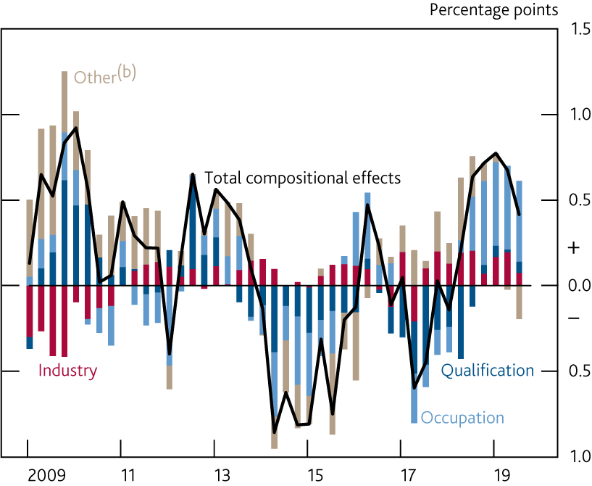
  Chart 3.14 Compositional effects have pushed up pay growth
    Estimates of the contribution of employment characteristics to four-quarter pay growth^{(a)}
Sources: Labour Force Survey and Bank calculations.
(a) Estimates are shown relative to their averages over 1995–2010. The effect of individual and job characteristics are derived from a regression of these characteristics on levels of pay. The total compositional effect is obtained by combining these estimates with changes in the composition of the labour force.
(b) Other includes age, tenure, gender, region of residence, whether full-time or part-time, in permanent or temporary employment, and in public or private sector employment.

Slide 16
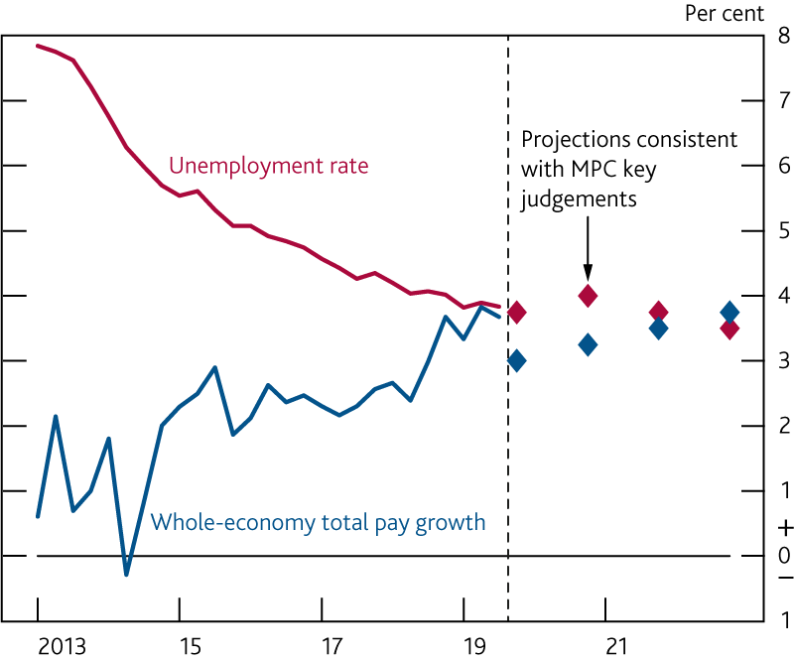
  Chart 3.15 Unemployment falls a little further in the MPC’s central projection
    Unemployment rate and four-quarter pay growth^{(a)}
Sources: ONS and Bank calculations.
(a) See Table 1.B for more information about the indicative projections consistent with the MPC’s forecast.

